Slide 1
A User-based Visual Analytics Workflow for Exploratory Model Analysis
Reference:
Cashman, D., Humayoun, S.R., Heimerl, F., Park, K., Das, S., Thompson, J., Saket, B., Mosca, A., Stasko, J., Endert, A., Gleicher, M. and Chang, R. (2019), A User‐based Visual Analytics Workflow for Exploratory Model Analysis. Computer Graphics Forum, 38: 185-199. doi:10.1111/cgf.13681
Link to this paper:
https://www.cs.tufts.edu/~remco/publications/2019/EuroVis2019-Snowcat.pdf

Slide 2
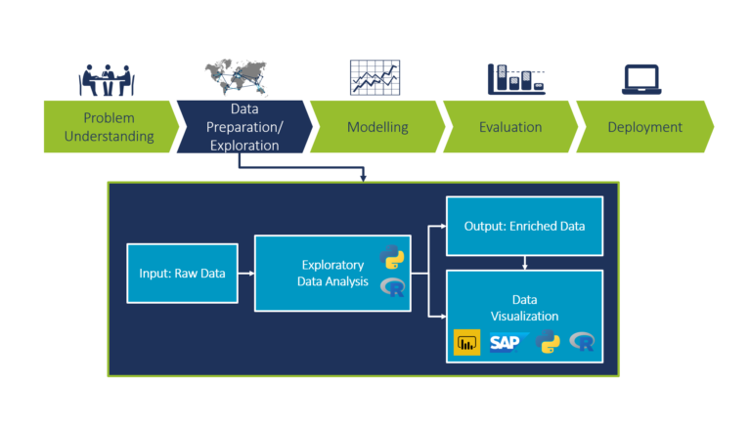
What is EDA?

Slide 3
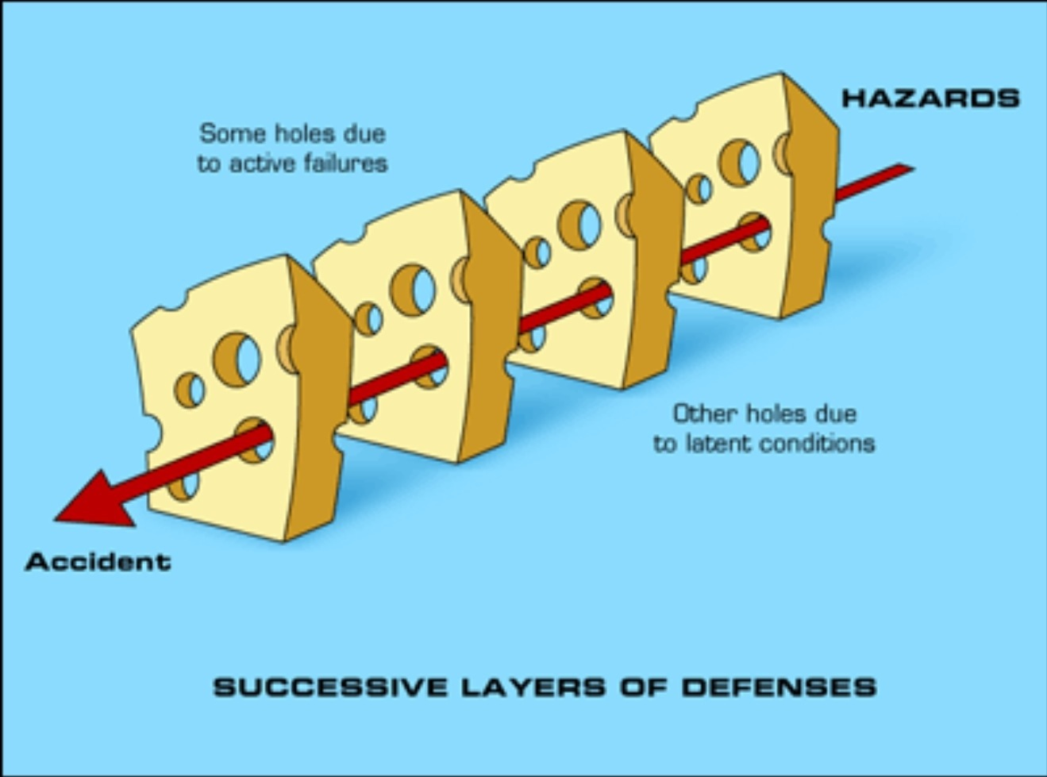
What is the problem?
Existing Interactive VA tool

Slide 4
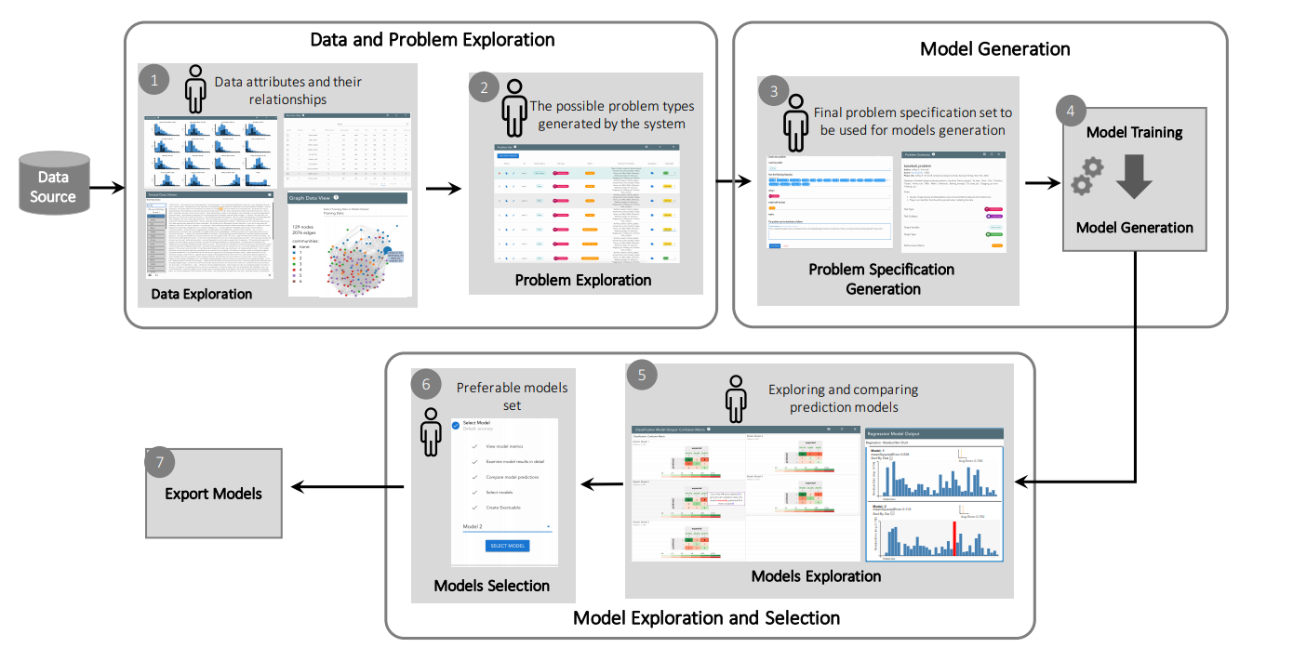
What is the proposed method?
The Proposed system

Slide 5
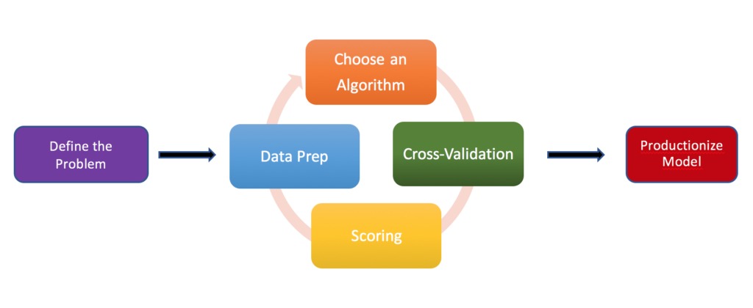
How does the proposed system help us?
EMA: I’ll do these. Just feed me the data !!

Slide 6
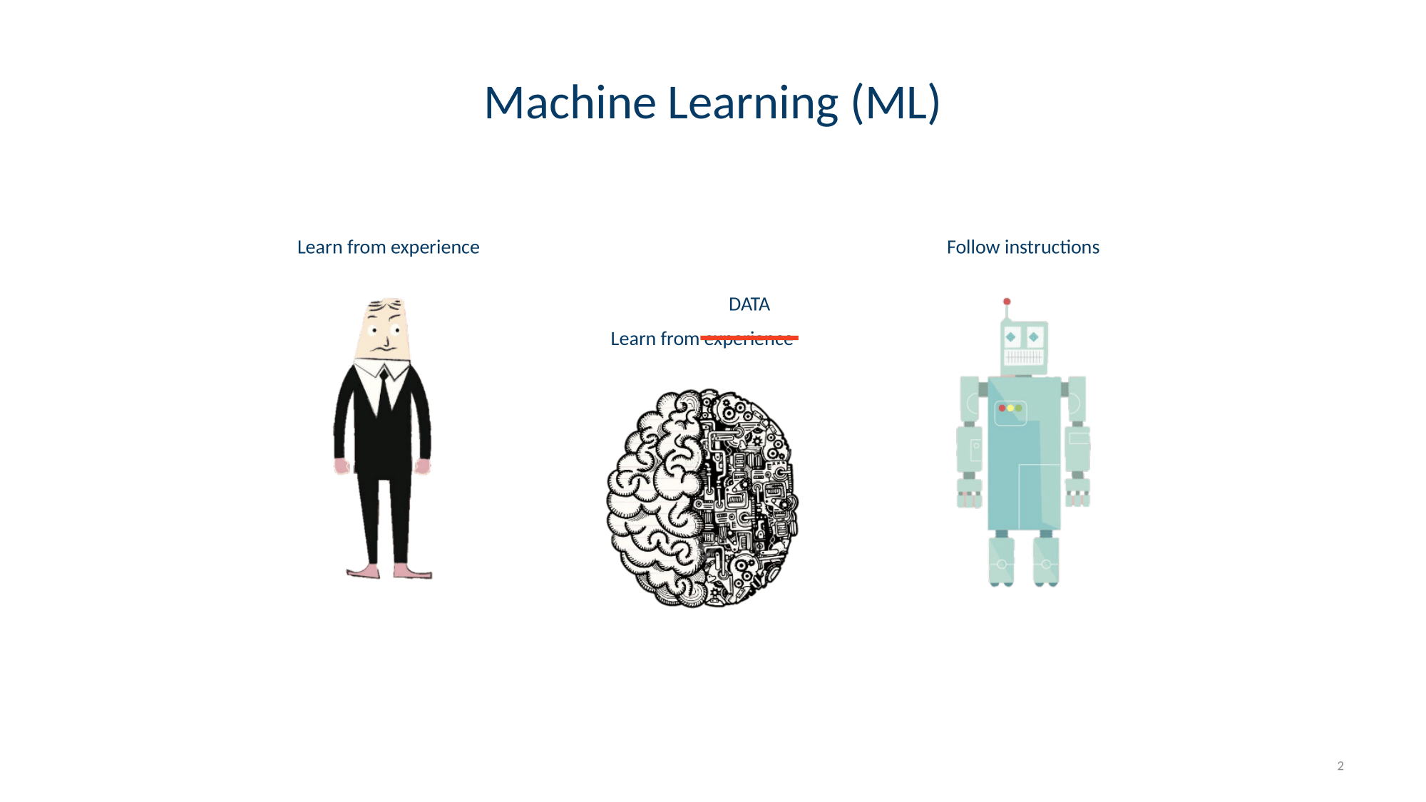
What is the main goal of EMA ?
Discover Replicable variables
Discover Replicable variables
Find a suitable model for the found variables

Slide 7
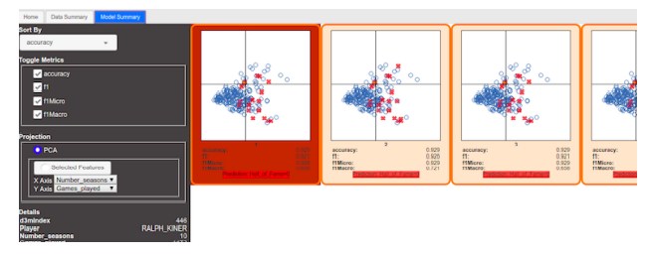
The Prototype Design
First Tab Second Tab

Slide 8
Task Requirements
G1
G2
G3
G4
G5
G6
Lorem 5
Use the data summary to generate the predictive models
Change and adjust the problem specification to get better predictive models.
Initially rank the predictive models.
Determine the most preferable model beyond the initial ranking.
Compare model predictions on individual data points
Transition seamlessly from one step to another in the overall workflow.

Slide 9
Workflow design- Step 1 and Step2

Slide 10
Workflow design Step 3 and Step 4

Slide 11
Workflow design Step 5, 6, 7

Slide 12
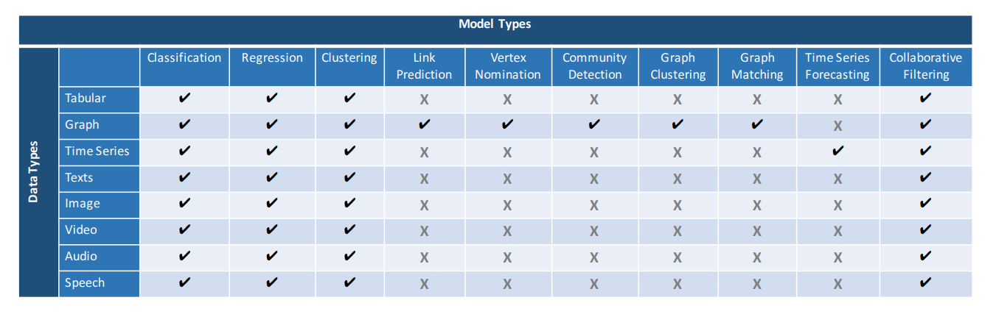
List of models supported by EMA
List of models and data types that the proposed EMA system supports

Slide 13
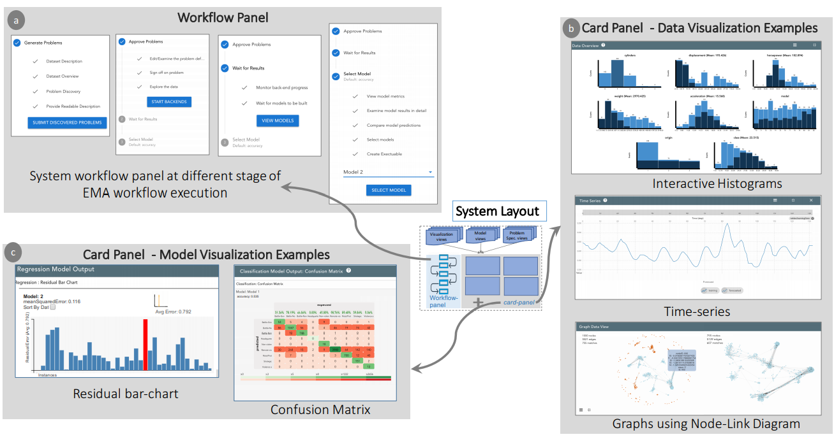
Components of the experimental system

Slide 14
Findings and FeedBacks
The user efficiency of the workflow was so good from the user feedback.
Reduces the work for user to choose between models.
“The default workflow containing comparisons of multiple models felt like a good conceptual structure to work in”

Slide 15
Suggestions for implementations
Difficulty in generating problem specifications for non-experts.
Displaying the outputs of all possible metrics instead of only one.
Providing a documented report about the findings.

Slide 16
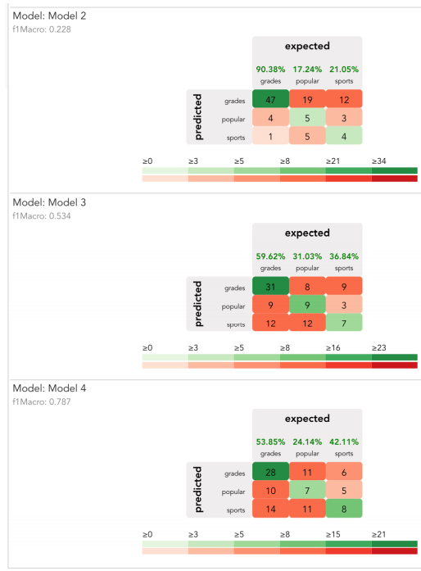
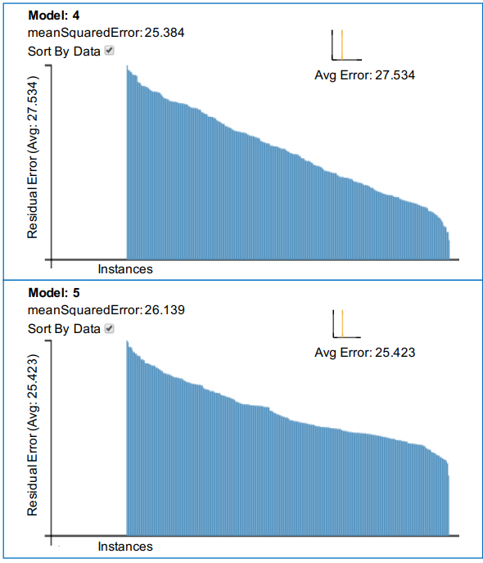
Use Cases:
The dataset used is
“Popular kid” and
“Automobile Fuel
Efficiency”
a) Confusion Matrix for classification B) Histogram for Regression

Slide 17
Conclusion
EMA
Defined as the process of discovering and selecting relevant models that can be used to make predictions on a data source
1
EMA Supports
EMA supports problem exploration, problem specification, and model selection in sequence.
2
User FeedBack
The steps of the workflow were clear and supported their ability to discover and export complex models on their dataset
3

Slide 18
Thanks!

